Slide 1
How we delivery software

Slide 2
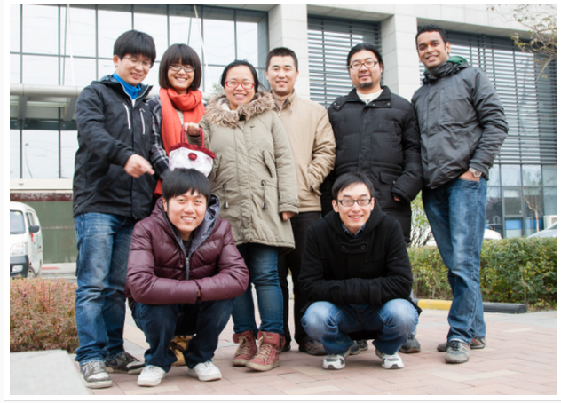
Who we are

Slide 3
What projects we are doing
Casa
Frond-end (DS)
Back-end (Jetwire/Feeder/Fast)
API(Provide data for native app of Andriod/IOS)
Sqaurefoot
China-site

Slide 4
How we delivery projects
Iteration
Story Card
Version Control
Feature toggle
Build system
Continuous Integration
Continuous Delivery

Slide 5
Iteration
Two weeks per iteration
Finish Story/Bug fix/Spike
Last Day of iteration
Branch cut off
Start new iteration number
Retrospect
End of iteration
Release package
Release note(package url/deployment guide)
Notes:
BDD 能否举个好例子, Luxury channel

Slide 6
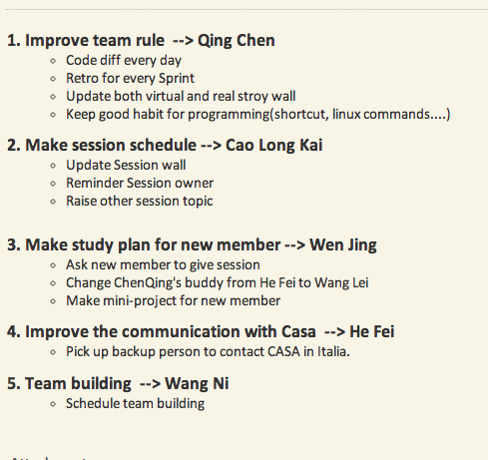
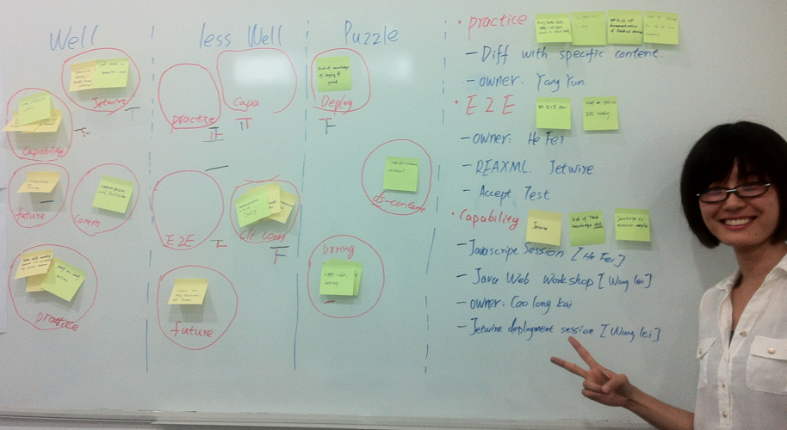
Retrospect
Notes:
BDD 能否举个好例子, Luxury channel

Slide 7
Story & Demo
Easy to track
Easy to understand
Easy to estimate
Easy to be test
Notes:
BDD 能否举个好例子, Luxury channel

Slide 8
Story Lifecycle & Action
BA
Requirement
Collection & Analysis
BA&QA
Story Card
Pick up
BDD
TDD
Implement
Commit
Deploy
Test
WebSite &
Mobile &
IPad
Deploy
Verify
Archive
Notes:
BDD 能否举个好例子, Luxury channel

Slide 9
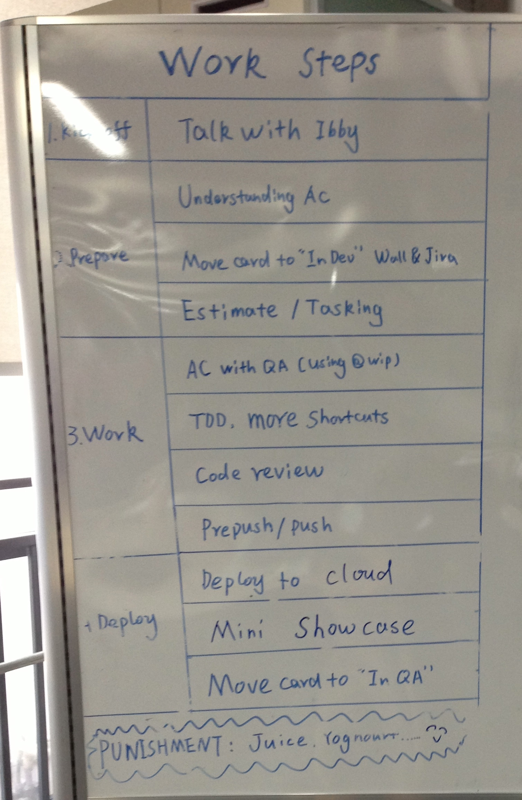
Development Steps
Notes:
BDD 能否举个好例子, Luxury channel

Slide 10
Development Steps
Pair/Pick up/Understand AC/Estimating/Tasking
BDD
Cucumber (make test fail)
TDD
Xunit(make test fail)
Implement (make test pass)
PrePush
Commit
Notes:
BDD 能否举个好例子, Luxury channel

Slide 11
Continuous Integration
CI Server
Jenkins (DS Build/Regression Test/Progression Test)
Bamboo (Feeder/Jetwire/…..)
Run All Tests
Build Package
Upload To Dist Server
Notes:
BDD 能否举个好例子, Luxury channel

Slide 12
Continuous Delivery
Cloud Environment(Create/Start/Stop/Destroy)
Amazon EC2
VMware Cloud
Infrastructure As Code
Chef
Puppet
Retrieve Package from dist server
Notes:
BDD 能否举个好例子, Luxury channel

Slide 13
Demo EC2
Deploy new package
Shutdown node
Create node
Destroy node
Notes:
BDD 能否举个好例子, Luxury channel

Slide 14
Other Activities
Standup meeting
Switch Pair
Code Diff
Session/Workshop
Notes:
BDD 能否举个好例子, Luxury channel

Slide 15
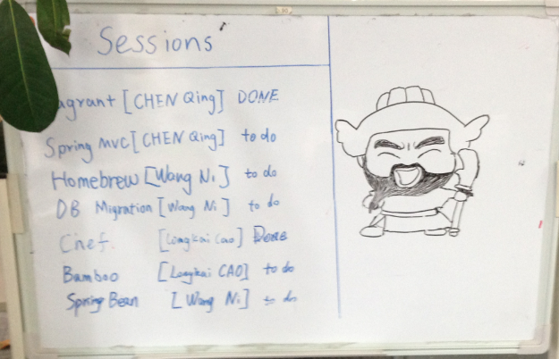
Session Wall
Notes:
BDD 能否举个好例子, Luxury channel

Slide 16
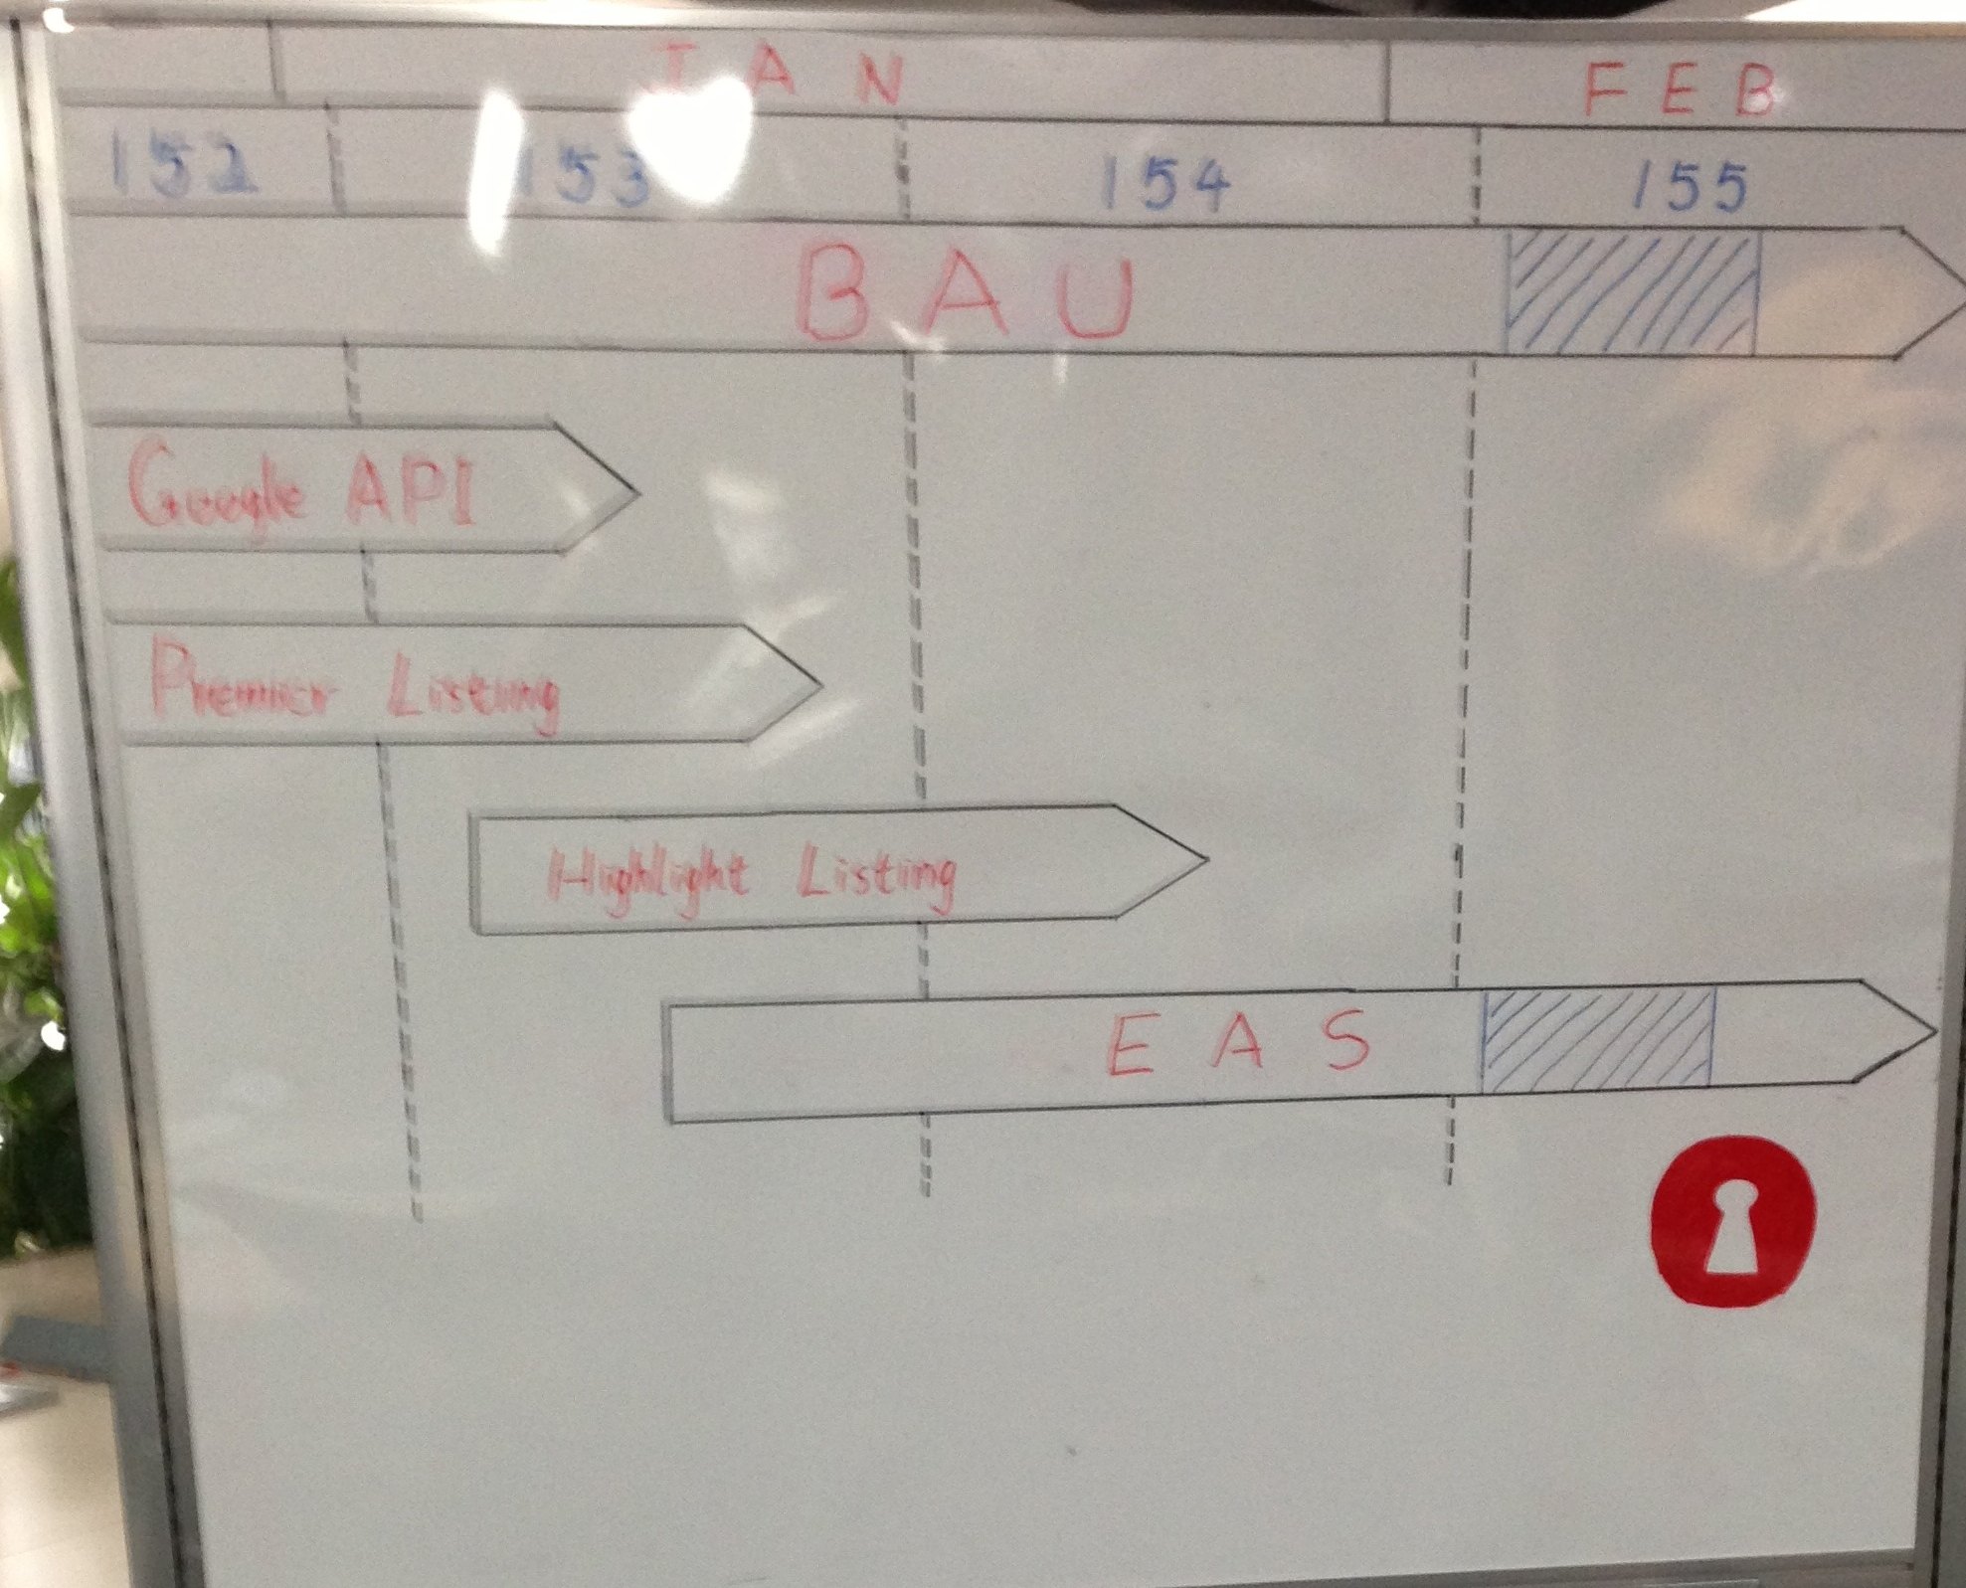
Target Wall
Notes:
BDD 能否举个好例子, Luxury channel

Slide 17
Q&A
Notes:
BDD 能否举个好例子, Luxury channel

